Slide 1
Data Structures Algorithm and Design SSZG519
Mr. Chennupati R Prasanna

Slide 2
SSZG519- Binary Search Tree

Slide 3
Binary Search Tree(BST)
Why Binary Search Tree?
We have discussed different tree representations and in all of them we did not impose any restriction on the nodes data
As a result, to search for an element we need to check both in left subtree and in right subtree.
Due to this, the worst case complexity of search operation is O(n)

Slide 4
We will discuss another variant of binary trees:
Binary search trees(BSTs).
As the name suggests, the main use of this representation is for searching. In this representation we impose restriction. on the kind of data a node can contain.
As a result, it reduces the worst case average search operation to O(logn)

Slide 5
Binary Search tree property
In binary search tree, all the left subtree elements should be less than root data and all the right subtree elements should be greater than root data
This is called binary search tree property, note that, this property should be satisfied at every node in the tree.
The left subtree of a node contains only nodes with keys less the nodes key.
The right subtree of a node contains only nodes with keys greater than the nodes key.
Both the left and right subtrees must also be binary search trees.

Slide 6
Binary search tree Property diagrammatic representation
Root
< Root
> Root

Slide 7
Example
7
3
7
1
6
4
9
2
7
2
5
Example: The left tree is a binary search tree and right tree is not binary search tree [at node 6 it’s not satisfying the binary search tree property]

Slide 8
Operations on Binary Search Trees:
Main operations: following are the main operations that are supported by binary search trees:
Find/find minimum/ find maximum element in binary search trees.
Inserting an element in binary search trees.
Deleting an element from binary search trees.

Slide 9
Important Notes on Binary Search Trees:
Since root data is always between left subtree data and right subtree data, performing inorder traversal on binary search tree produces a sorted list.
While solving problems on binary search trees, first we process left subtree, then root data and finally we process right subtree. This means, depending on the problem only the intermediate step(processing root data change and we do not touch the first and third steps)
If we are searching for an element and if the left subtree roots data is less than the element we want to search then skip it. Same is the case with right subtree. Because of this, binary search trees take less time for searching an element than regular binary trees.
In other words, the binary search trees consider either left or right subtrees for searching an element but not both.

Slide 10
Finding an element in Binary Search Trees.
Find operation is straight forward in a BST. Start with the root and keep moving left or right using the BST property.
If the data we are searching is same as nodes then we return current nodes. if the data is not present, we end up in a Null Link.
what is the time complexity of finding the element in binary search tree ?
O(n) lets discuss about this !

Slide 11
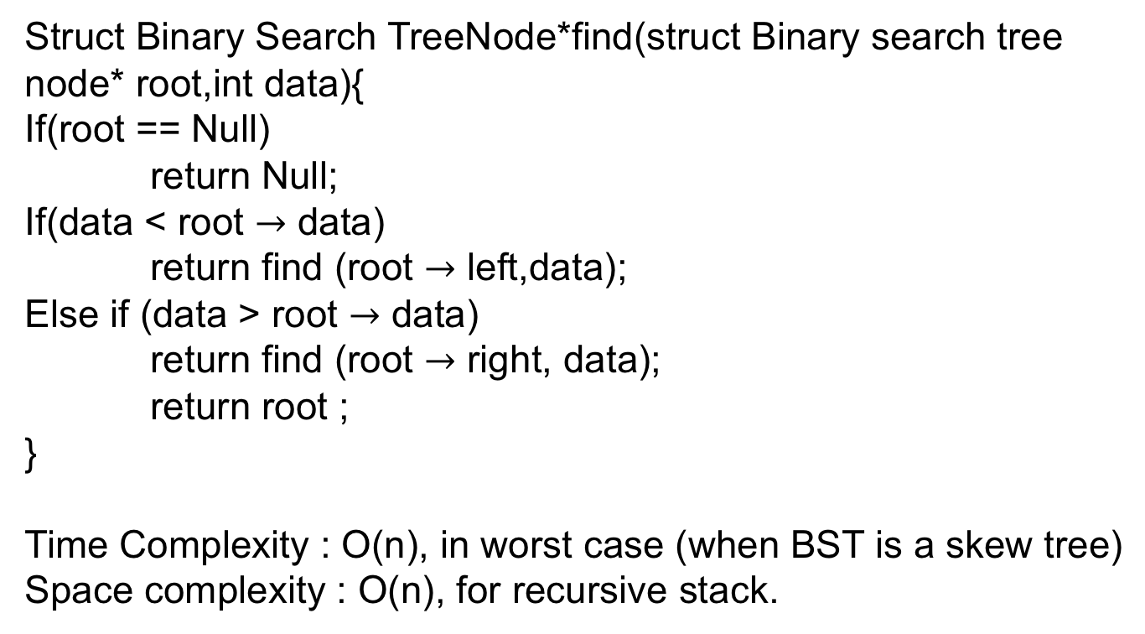
Struct Binary Search TreeNode*find(struct Binary search tree node* root,int data){
If(root == Null)
return Null;
If(data < root $→$ data)
return find (root $→$ left,data);
Else if (data > root $→$ data)
return find (root $→$ right, data);
return root ;
}
Time Complexity : O(n), in worst case (when BST is a skew tree)
Space complexity : O(n), for recursive stack.

Slide 12
Finding minimum element in Binary search trees:
In BSTs, the minimum element, is the left-most node, which does not has left child. In the BST below, the minimum element is 4.
Tree-Minimum(x)
1. while left[x] ≠ NIL
2. do x ← left[x]
3. return x
Time complexity O(n) in the worst case
Space complexity O(n) for recursive Stack
10
6
16
4
9
13
7

Slide 13
Finding max element in Binary search trees:
In BSTs the Maximum element is the right –most node which does not have right child. In the BSTs above the maximum element is 16.
Tree-Maximum(x)
1. while right[x] ≠ NIL
2. do x ← right [x]
3. return x
Time complexity O(n) in the worst case
Space complexity O(n) for recursive Stack
10
6
16
4
9
13
7

Slide 14
Where is In-order Predecessor & Successor.
Where is the in-order predecessor and successor of node X in a binary search tree assuming all keys are distinct?
If X has two children then its in-order predecessor is the maximum value in its left subtree and its in-order successor the minimum value in its right subtree.
Fig-1: If it does not have a left child a node in-order predecessor is its first left ancestor.
Fig-1

Slide 15
Inserting an element from Binary Search tree:
To insert data into binary search tree, first we need to find the location for that element. We can find the location of insertion by following the same mechanism ad that of find operation.
While finding the location if the data is already there then we can simply neglect and come out.
Otherwise, insert data at the last location on the path traversed.
An an example, let us consider the above tree. The dotted node indicates the element (5) to be inserted, to insert 5, traverse the tree as using the find function. At node with key 4, we need to go right but there is no subtree, so 5 is not in the tree, and this is the correct location for insertion.
Time complexity :O(n), in worst case

Slide 16
Deleting an element from binary search tree:
The deleting operation is more complicated than other operations. This is because may not be the leaf node. In this operation also, first we need to find the location of the element which we want to delete .
Since we have found the node to be deleted, consider the following cases:
If the element to be deleted is a leaf node:

Slide 17
Deleting an element from binary search tree(Cont..,)
If the element to be deleted has one child:
17

Slide 18
Deleting an element from binary search tree(Cont..,)
If the element to be deleted has both children: the general strategy is to replace the key of this node with the largest element of the left subtree and recursively delete the node.
Time complexity :O(n)

Slide 19
Balanced Binary Search Trees:
We have seen different trees whose worst case complexity is O(n).
Where n is the number of nodes in the tree. This happens when the trees are skew trees.
Will try to reduce this worst case complexity to O(logn) by imposing restrictions on the heights.
In general, the height balanced trees, are represented with HB(K), Where K is the difference between left subtree height and right subtree height.
Sometimes K is called balance factor.

Slide 20
Balanced Binary Search Trees(Cont..,)
If HB(K), if K = 0( if balance factor is zero), then we call such binary search trees as full balanced binary search trees.
That means, in HB(0) binary search tree, the difference between left subtree and right subtree height should be at most zero.

Slide 21
AVL(Adelson-Velskii & Landis) Tree
In HB(K), if K – 1(if balance factor is one), such binary search tree is called an AVL tree. That means an AVL tree is a binary search tree with a balance condition the difference between left subtree height and right subtree height is at most 1.
Properties of AVL Trees:
It is a binary search tree, and
For any node X, the height of left subtree of X and height of right subtree of X differ by at most 1.
As an example the above binary search trees, the left one is not an AVL tree, where as the right binary search tree is an AVL tree.
Fig-1
Fig-2

Slide 22
Rule to convert from Non-AVL to AVL know as AVL-Rotation
Left-rotations: Used when nodes is inserted into right subtree[of right subtree] after inserting new node tree becomes unbalanced.
1
2
2
3
1
3

Slide 23
AVL-Rotation (cont..,)
Right-Rotation: Node is inserted in the left of left-subtree.
3
2
2
1
3
1
23

Slide 24
AVL Rotation (Double rotation)
Left-right rotation (Double Rotation): Node is inserted in the right of left-subtree and makes the tree unbalanced.
4
3
2

Slide 25
AVL Rotation (Double rotation) cont..,
Right-Left Rotation: Node is inserted in the left of right subtree and make the tree unbalanced.
3
4
4
5

Slide 26



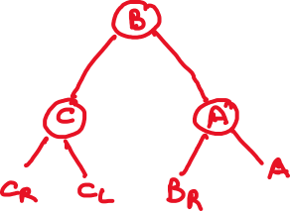
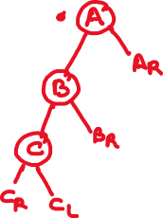
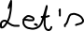

Slide 27






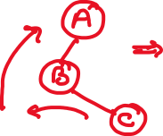



Slide 28







Slide 29

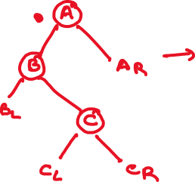

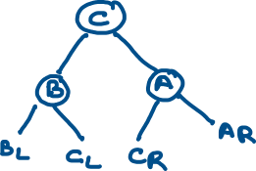


Slide 30
AVL-Tree (Insertion)
1,2,3,6,7,5 Example
Step-1
Step-2
Step-3

Slide 31
AVL-Tree (Insertion) Example
Step4: As inserting is or right subtree

Slide 32
AVL-Tree (Insertion) Example Cont..,

Slide 33
Delete an element from AVL Trees
Simple remove the node with all three case of BST
No child
One child
Both children available
Calculate B.F again
A is nearest ancestor of deleted node
If deleted node are from left subtree of A then It is called Type L delete otherwise it is called Type R delete

Slide 34
Type-R
Type-R
R(0)
R(1)
R(-1)
Balance of Left sybling

Slide 35
Example
8
A
8
Del (10)
5
5
10
3
7
3
7
Since it R(0) type apply right rotation on A
5
3
8
7

Slide 36
Example
8
A
8
Del (10)
5
5
10
3
3
Since it R(1) type apply right rotation on A
5
3
8

Slide 37
Another-Example
8
8
A
Del (10)
5
10
5
7
7
Since it R(-1) type apply left Rotation on left child of node A and Then right rotation on node A
8
A
7
7
RR on A
5
8
5

Slide 38
Type-L
Type-L
L(0)
L(1)
L(-1)
Balance of Right sybling

Slide 39
Example
8
8
A
Del (5)
20
5
20
10
26
10
26
Since it L(0) type apply Left rotation on A
20
8
26
10

Slide 40
Example
8
8
Del (5)
5
20
20
26
26
Since it L(-1) = case apply Left rotation on A
20
8
26

Slide 41
Example on AVL-Deletion continues
8
8
Del (5)
5
20
20
10
10
Since it L(1), In L₁ case we have to solve in two steps,
Step1: Right Rotation at right child of ‘A’
Step2: Left rotation at node A
8
10
10
8
20
20

Slide 42
Thank You!!

